Slide 1



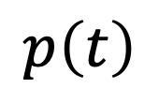

Iwasa et al.
Fig. 1
heat stress
$$h\left(t\right)$$
isoprene
production
photosynthesis
$$s\left(t\right)$$
$$λ\left(t\right)$$
$$p\left(t\right)$$
$$b\left(t\right)$$
effectiveness

Slide 2
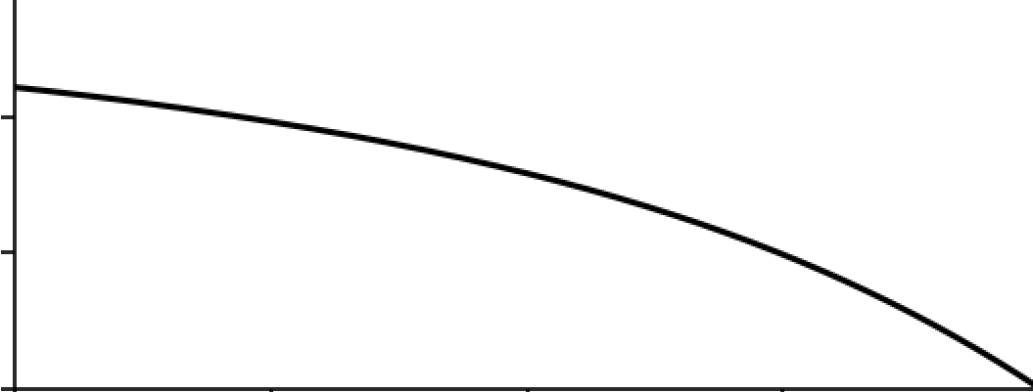
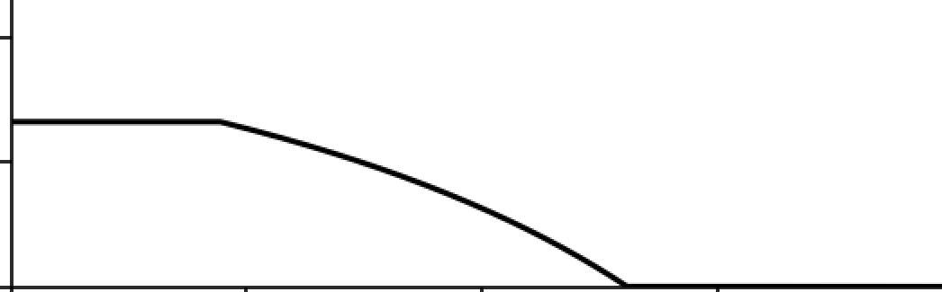














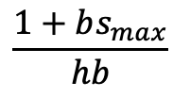








Iwasa et al.
Fig. 2
$$\frac{1+bs_{max}}{hb}$$
$$λ\left(t\right)$$
$$0.4$$
marginal value
of leaf area
$$λ\left(t\right)$$
$$\frac{1}{hb}$$
$$0.2$$
$$λ\left(t\right)$$
$$0$$
$$t_{f}$$
$$0$$
$$t$$
$$t_{s}$$
$$T$$
$$0.2$$
$$s_{max}$$
isoprene production
$$0.1$$
$$s\left(t\right)$$
$$0$$
$$t_{f}$$
$$t_{s}$$
$$0$$
$$t$$
$$T$$

Slide 3
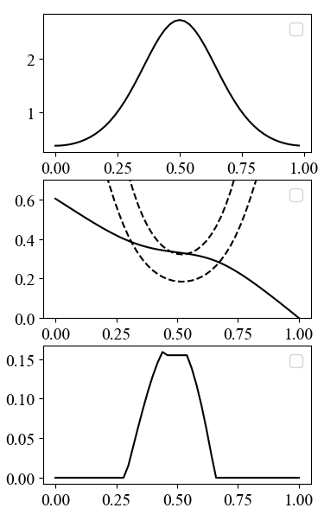





Iwasa et al.
Fig. 3
$$h\left(t\right)$$
heat stress
$$\frac{1+b\left(t\right)s_{max}}{h\left(t\right)b\left(t\right)}$$
$$λ\left(t\right)$$
marginal value
of leaf area
$$\frac{1}{h\left(t\right)b\left(t\right)}$$
$$s\left(t\right)$$
isoprene
production
$$t$$
Notes:
t刻み幅を小さくして計算する。

Slide 4
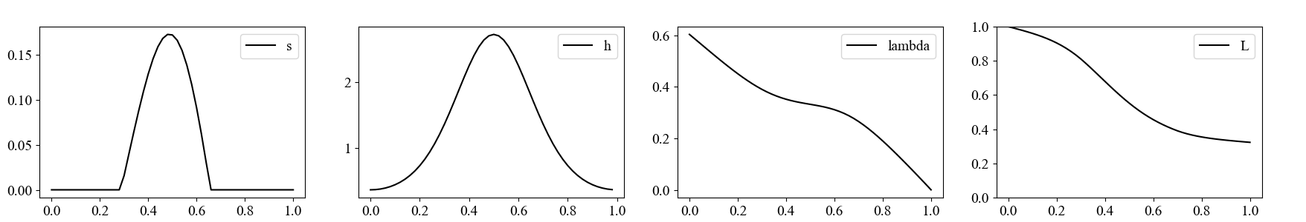
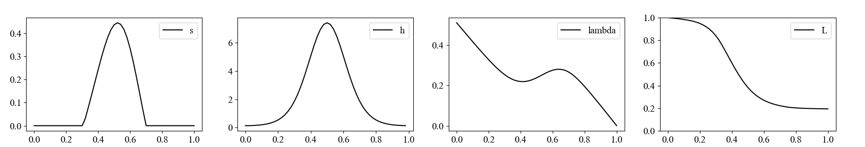
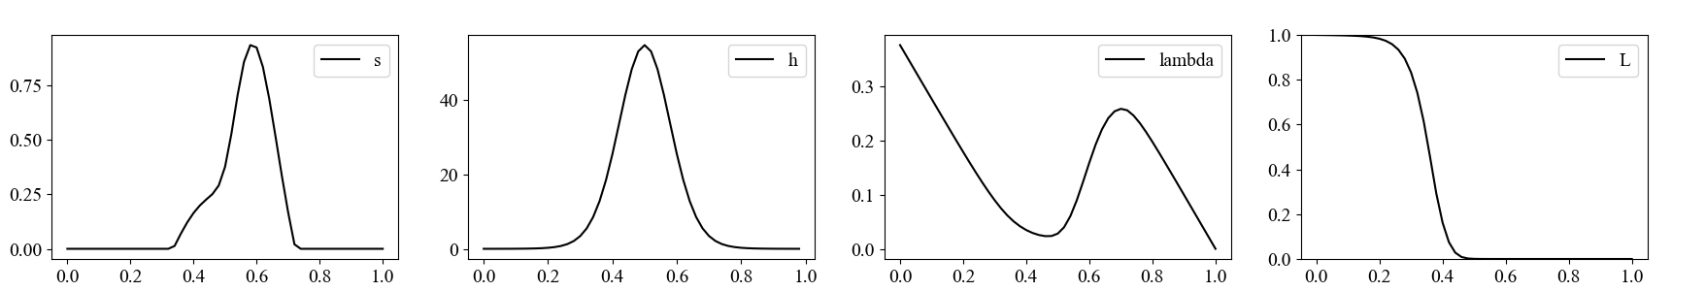









Iwasa et al.
Fig. 4
isoprene production
heat stress
marginal value
leaf area
$$s\left(t\right)$$
$$h\left(t\right)$$
$$λ\left(t\right)$$
$$L\left(t\right)$$
$${ b}_{1}=1$$
$$b_{1}=2$$
$$b_{1}=4$$
$$t$$
$$t$$
$$t$$
$$t$$

Slide 5
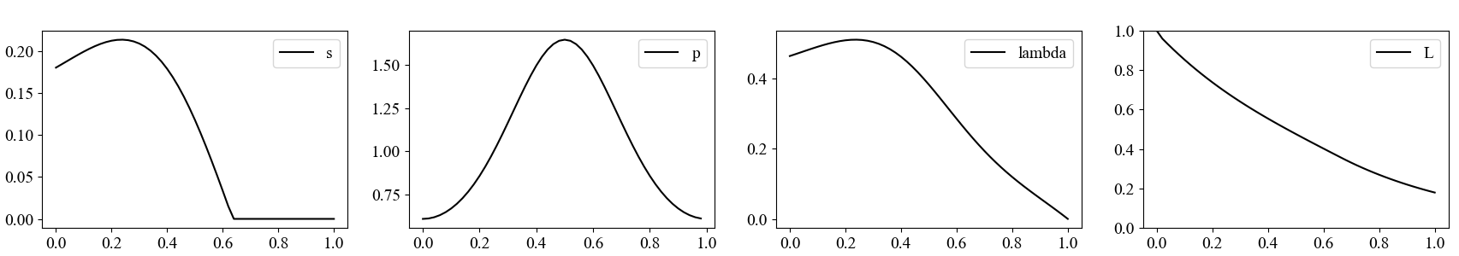
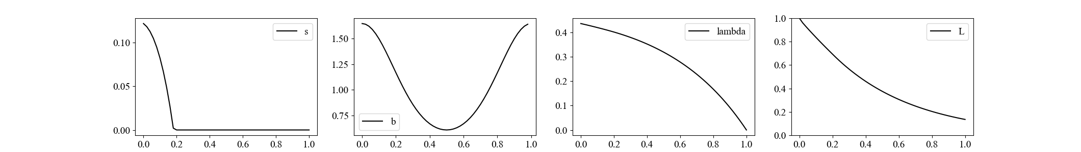













Iwasa et al.
Fig. 5(a)(b)
(a)
isoprene production
photosynthesis
marginal value
leaf area
$$s\left(t\right)$$
$$p\left(t\right)$$
$$λ\left(t\right)$$
$$L\left(t\right)$$
$$t$$
$$t$$
$$t$$
$$t$$
(b)
isoprene production
photosynthesis
marginal value
leaf area
$$s\left(t\right)$$
$$b\left(t\right)$$
$$λ\left(t\right)$$
$$L\left(t\right)$$
$$t$$
$$t$$
$$t$$
$$t$$

